Slide 1
Loyalty Points Calculation and Bonus Distribution for ABC Gaming
By- Kumari Neha

Slide 2
INTRODUCTION
ABC is a real-money online gaming platform where players register, deposit money, play games like Ludo, and withdraw their winnings, with a small service fee charged by the platform. To keep players engaged, ABC has created a loyalty program that rewards users with loyalty points based on their deposits, withdrawals, and the number of games played.
This project’s goal is to analyze player activity for October, calculate loyalty points according to defined criteria, and rank players based on their points. At the end of the month, the top 50 players will receive cash rewards from a fixed Rs 50,000 bonus pool, divided based on their rankings. This setup helps ABC retain users by incentivizing active engagement on the platform.

Slide 3
OBJECTIVE
Calculate player-wise loyalty points for specified slots in October.
Assess overall loyalty points and rank players for the month.
Determine the average deposit amount and deposits per user.
Calculate the average number of games played per user.
Propose a fair distribution of a Rs 50,000 bonus among the top 50 players.
Evaluate the fairness of the loyalty points formula and recommend enhancements.

Slide 4
SCOPE
Calculate loyalty points for specific dates and rank players.
Analyze player activity regarding deposits and games played.
Suggest a fair bonus distribution method for the top 50 players.
Evaluate and propose improvements to the loyalty points formula.
.

Slide 5
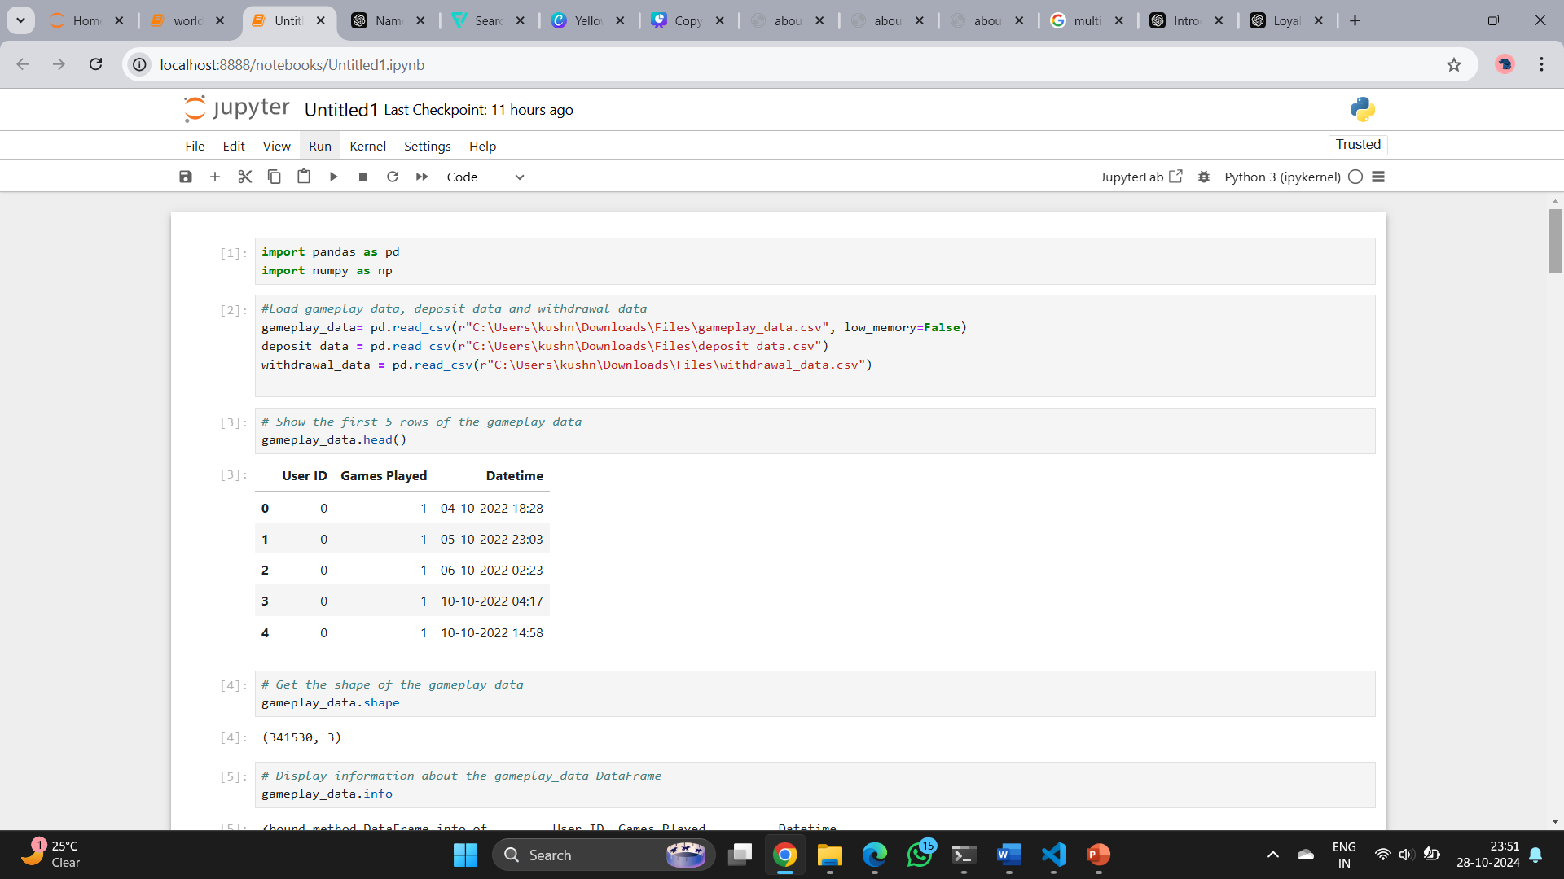
Import Packages and Load Data

Slide 6
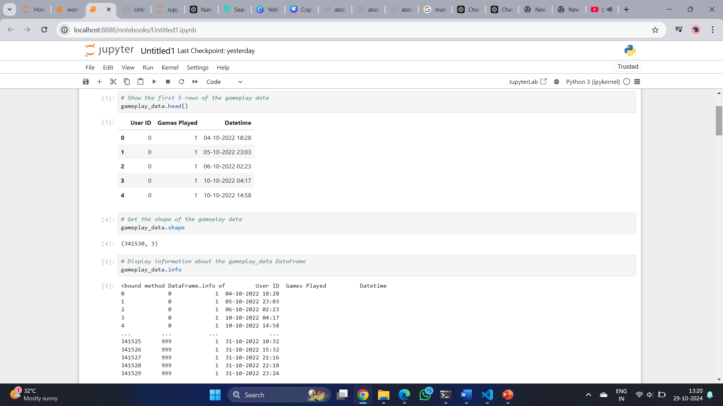
Game Play Data Head

Slide 7
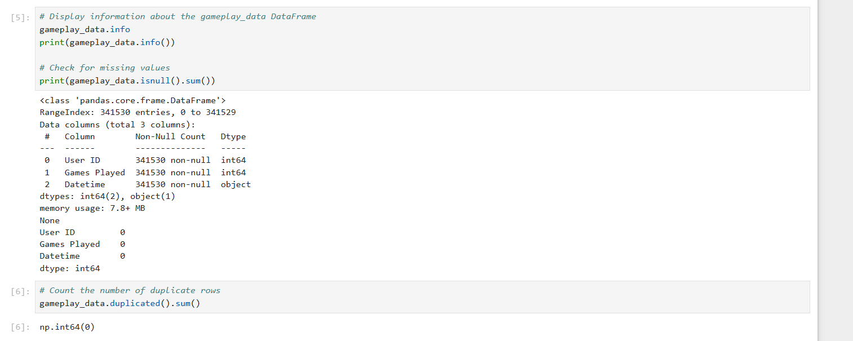
Data Cleaning

Slide 8
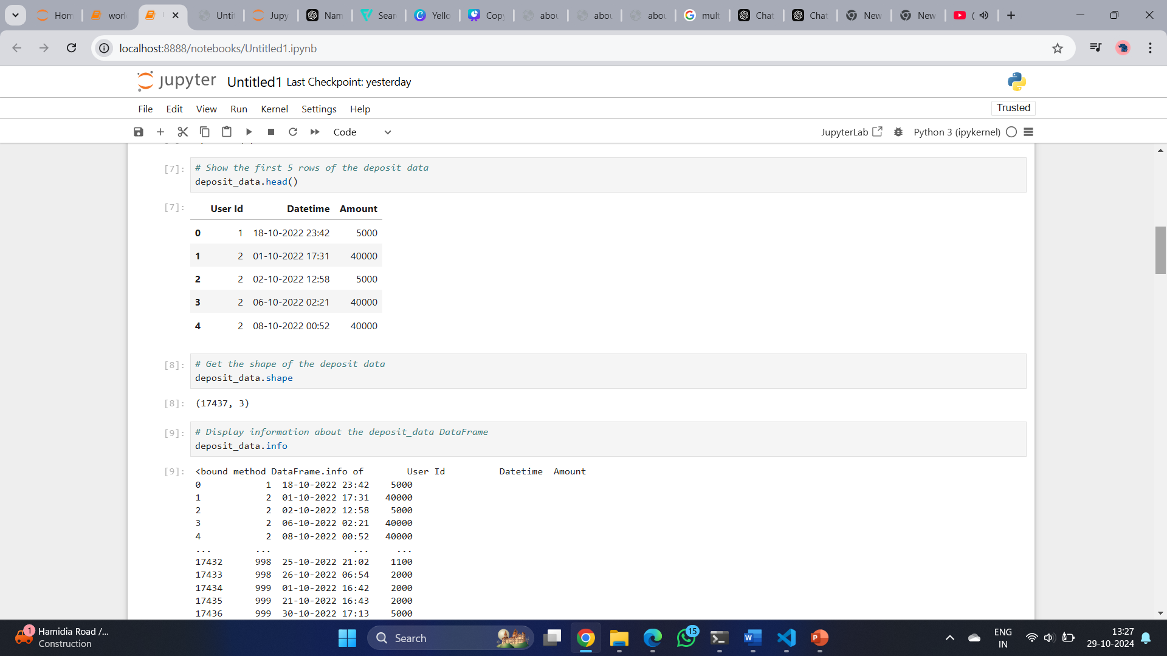
Deposit Data Head

Slide 9
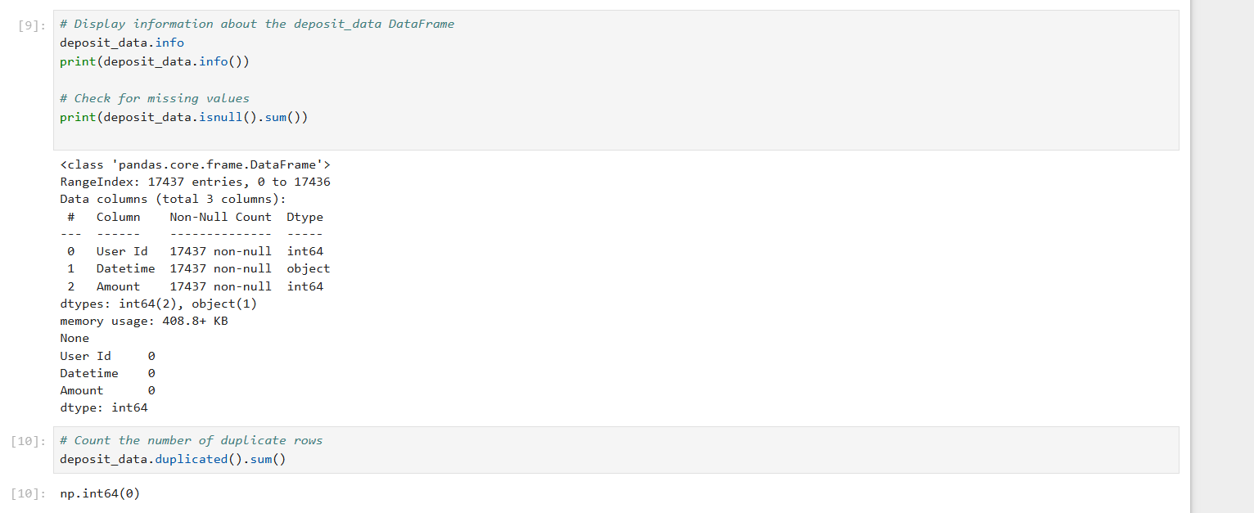
Data Cleaning

Slide 10
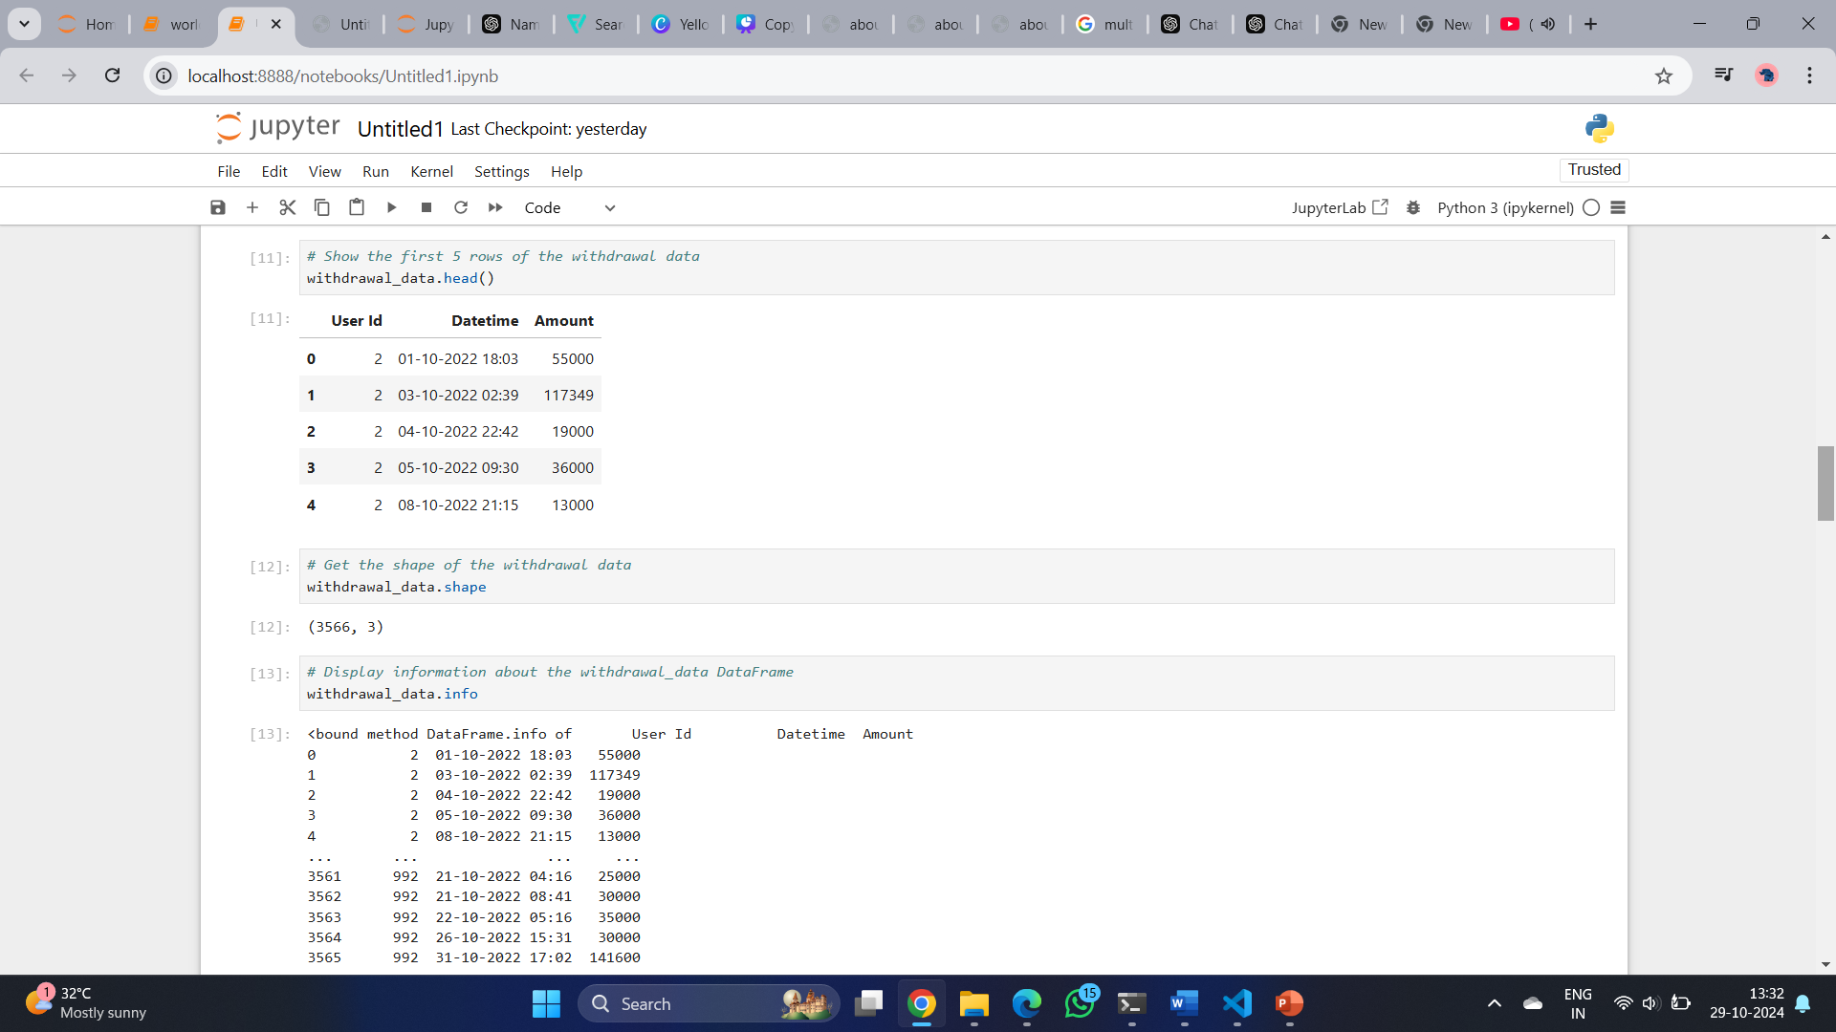
Withdrawal Data Head

Slide 11
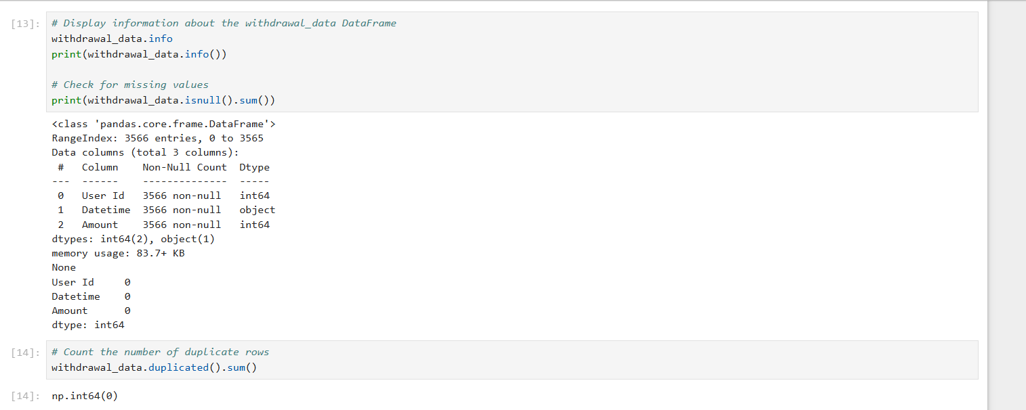
Data Cleaning

Slide 12
Part A - Calculating loyalty points
Data Processing: Load the data for the specified dates and calculate loyalty points based on the given formulas.
Analysis: Compile overall loyalty points and rank players.
Statistical Analysis: Calculate average deposit amounts and average games played.

Slide 13
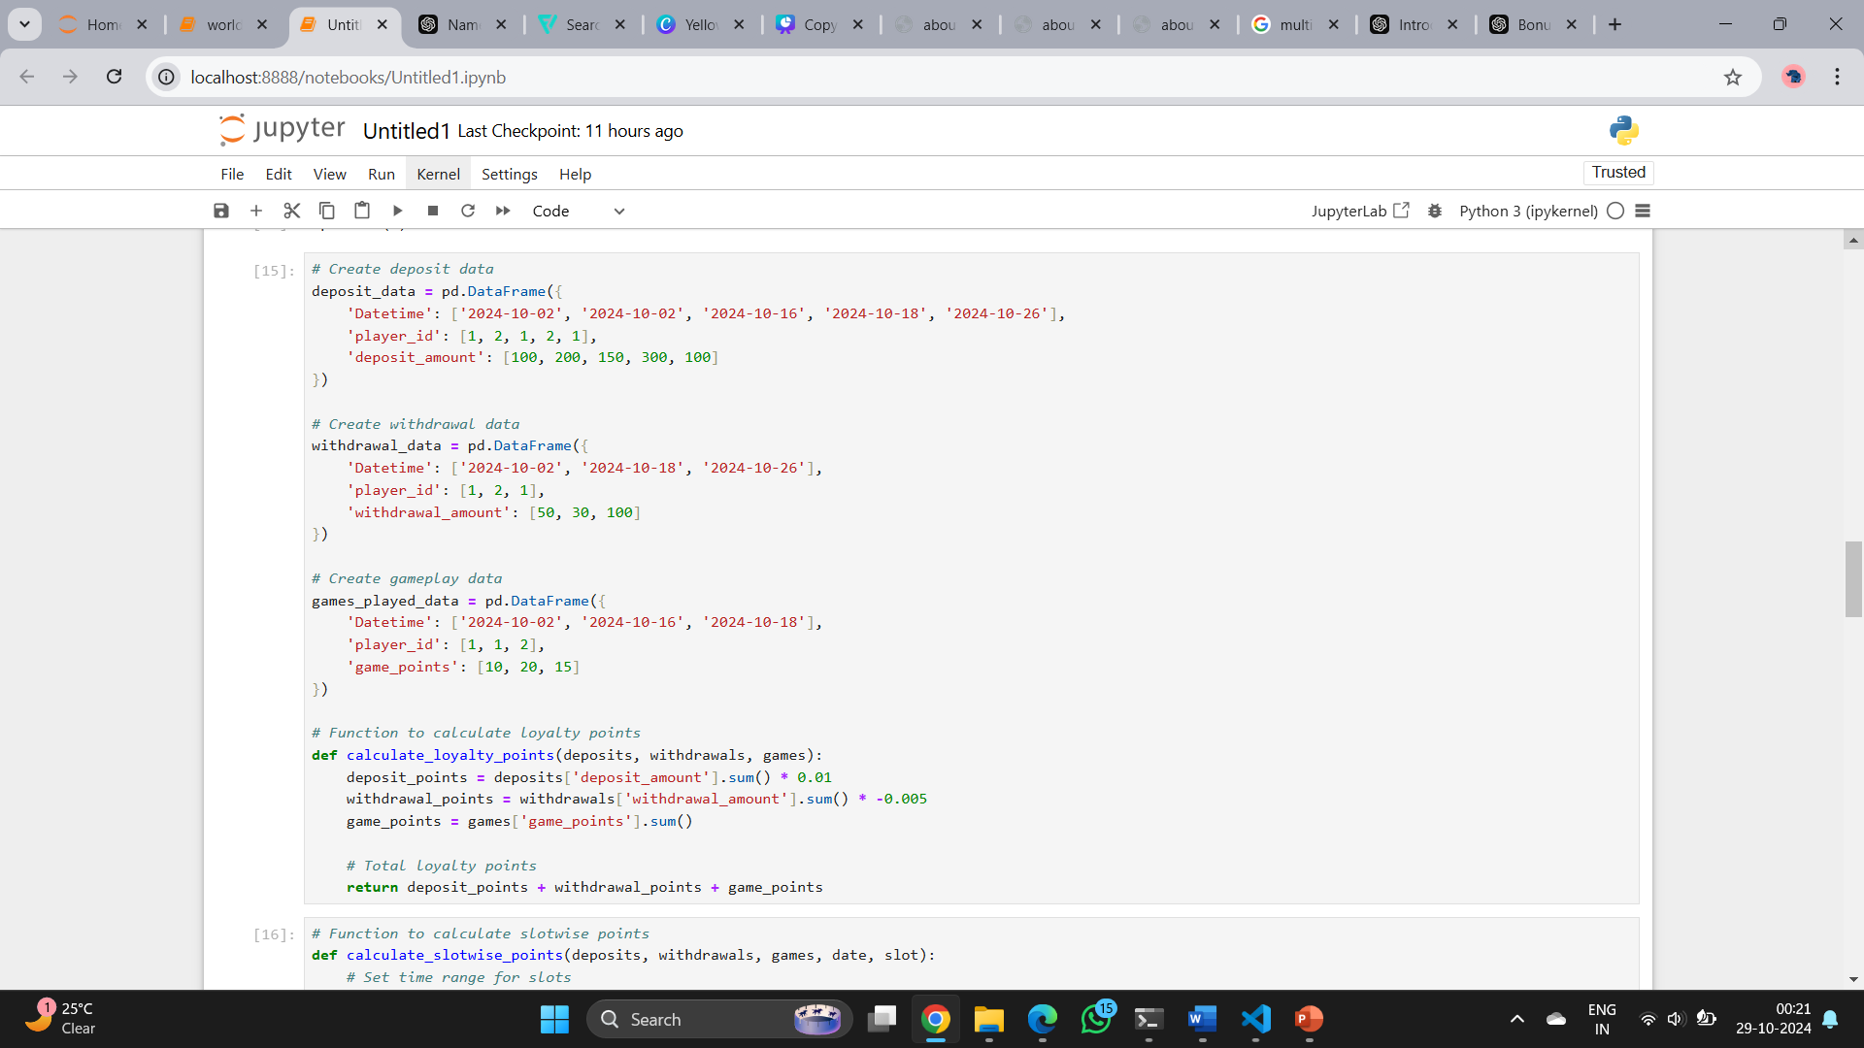
1. Find Playerwise Loyalty points earned by Players in the following slots:-
a. 2nd October Slot S1, b. 16th October Slot S2, c. 18th October Slot S1, d. 26th October Slot S2

Slide 14
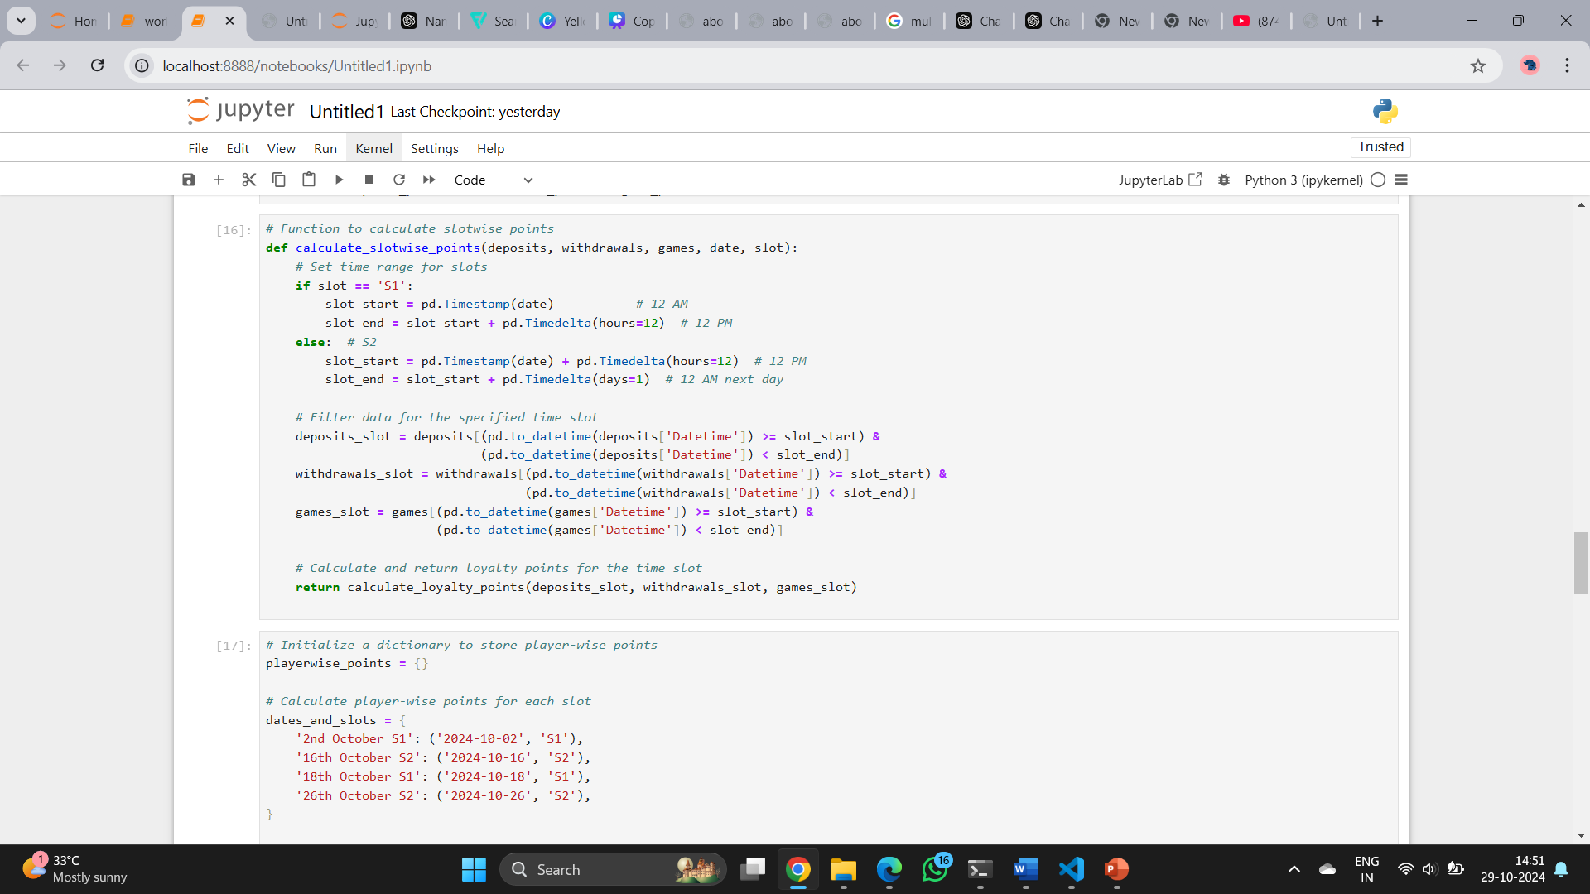

Slide 15
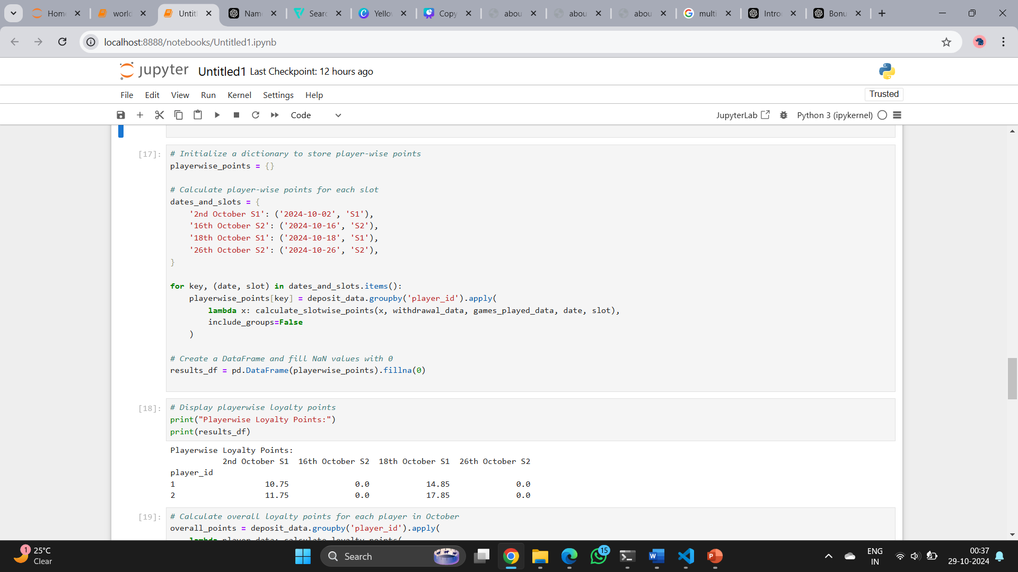

Slide 16
OUTPUT

Slide 17
The output shows loyalty points for two players across specific dates and time slots in October 2024:
Playerwise Loyalty Points:
Player 1:
2nd October S1: 10.75 points
16th October S2: 0.0 points
18th October S1: 14.85 points
26th October S2: 0.0 points
Summary:
Both players earned points on October 2 and 18.
No activity on October 16 and 26 resulted in 0.0 points for those slots.
Player 2:
2nd October S1: 11.75 points
16th October S2: 0.0 points
18th October S1: 17.85 points
26th October S2: 0.0 points

Slide 18
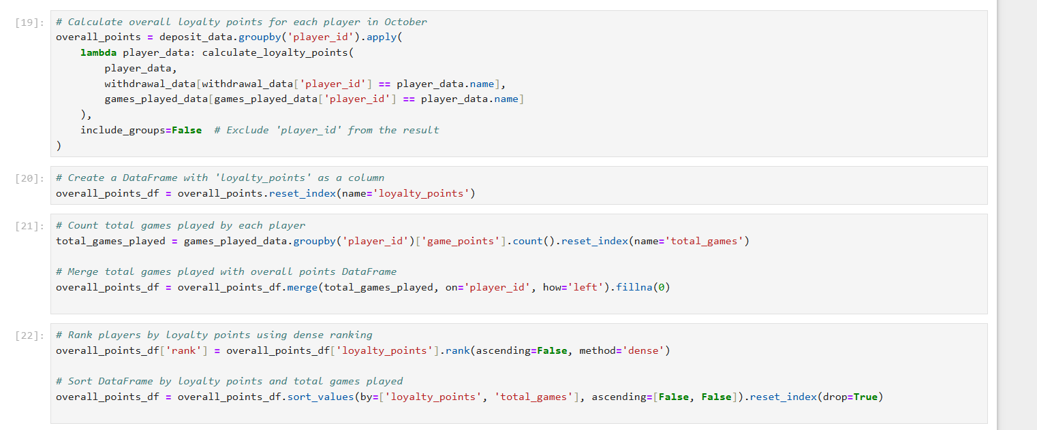
2. Calculate overall loyalty points earned and rank players on the basis of loyalty points in the month of October. In case of tie, number of games played should be taken as the next criteria for ranking.

Slide 19
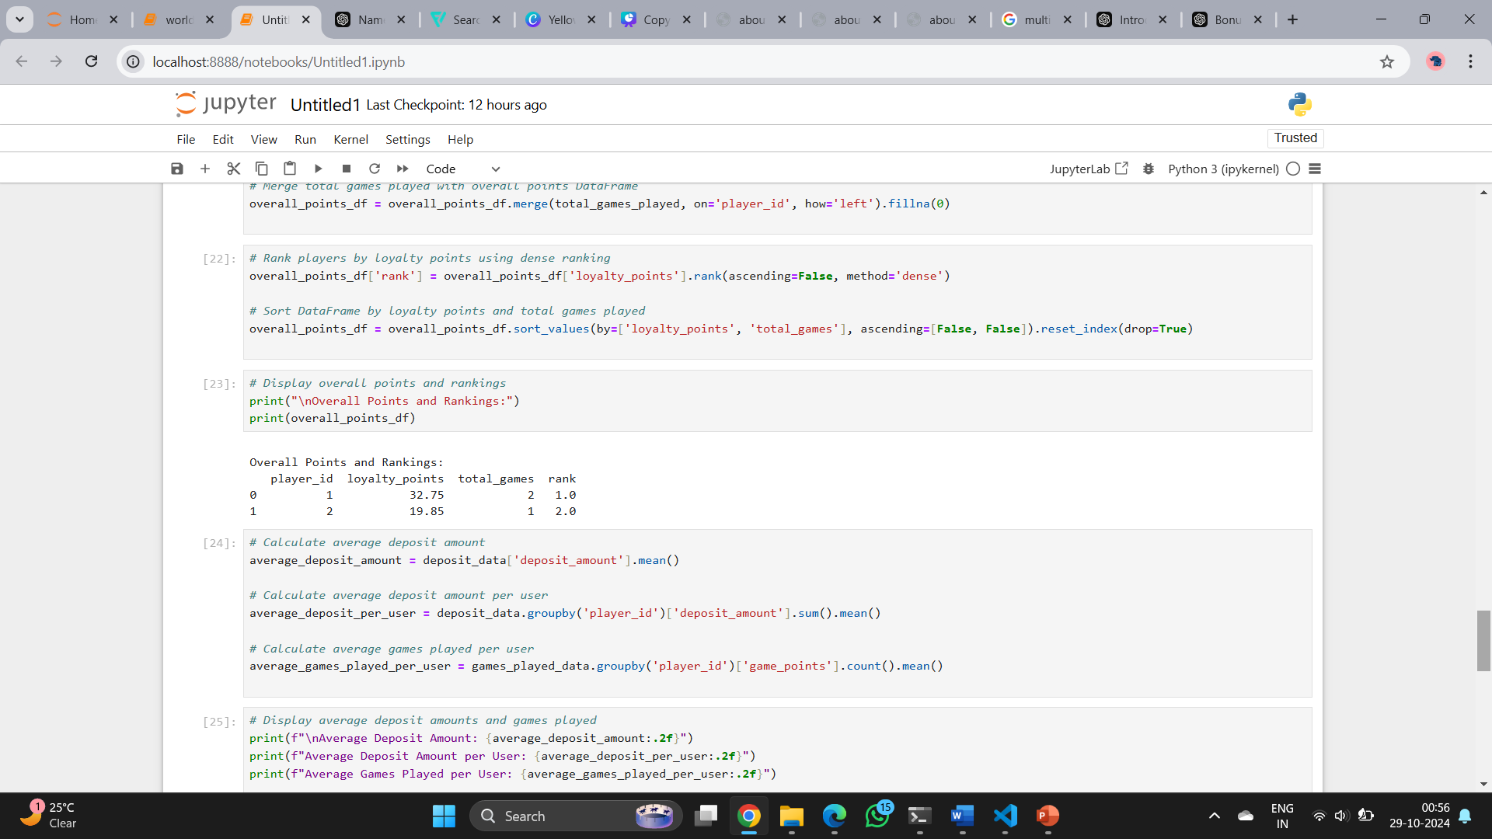
OUTPUT
Player 1 has the highest loyalty points and games played, while Player 2 has lower loyalty points and games played.

Slide 20
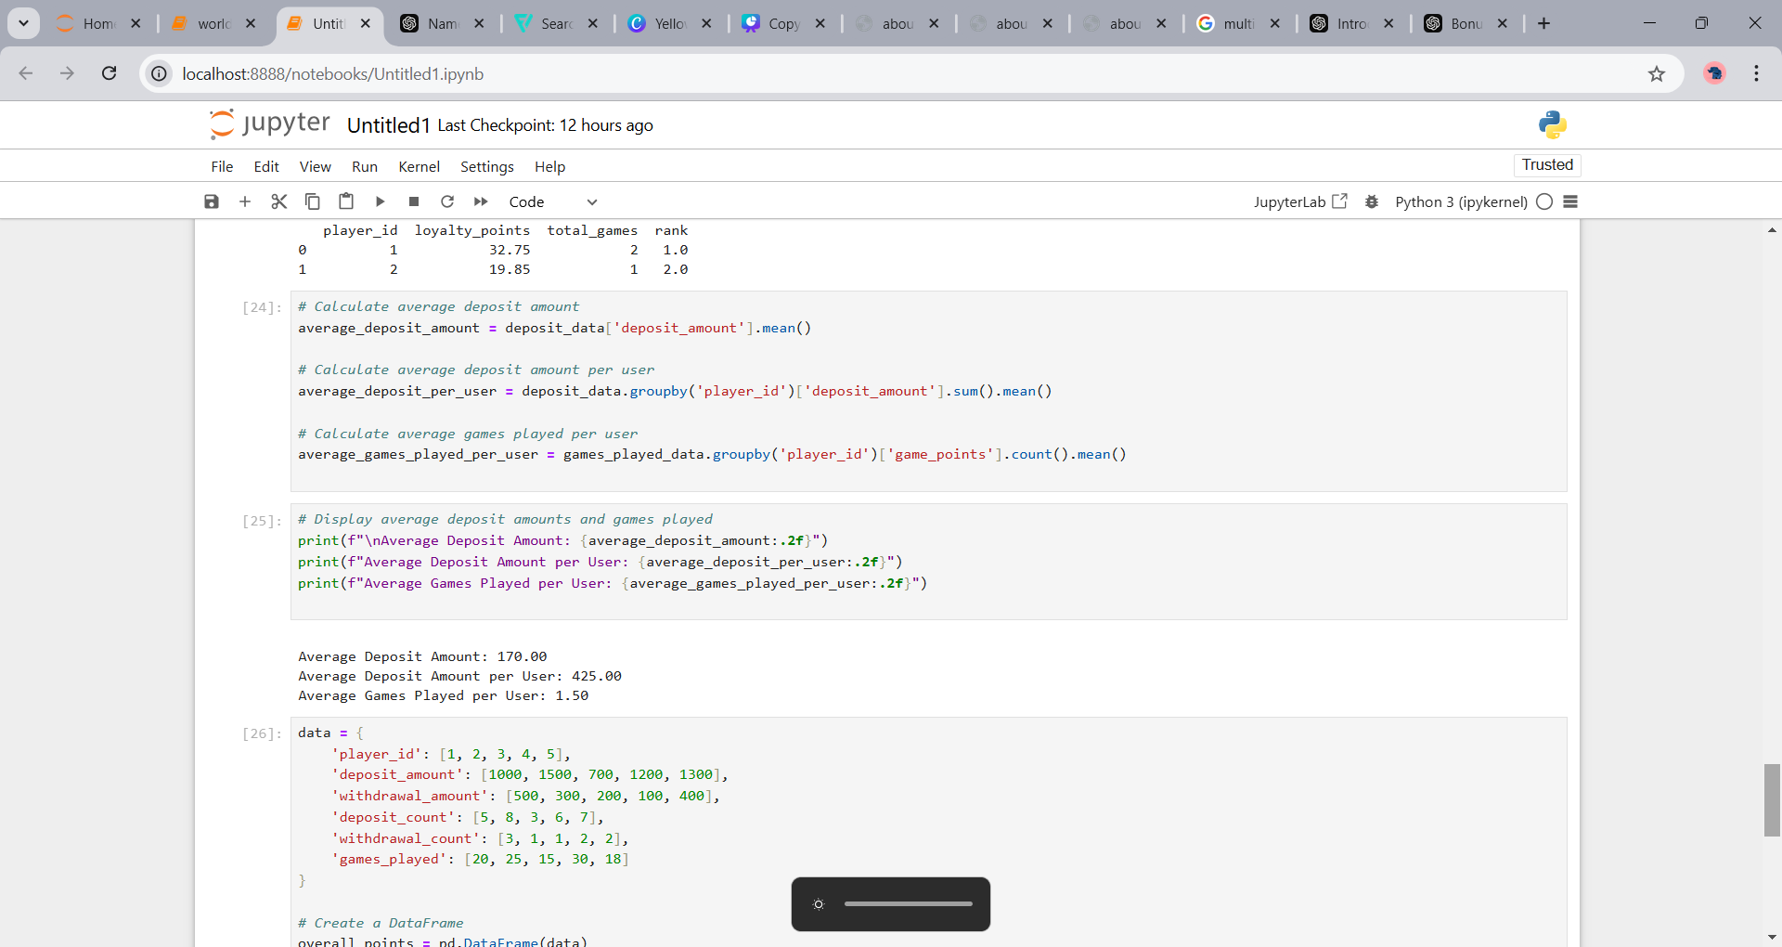
3. What is the average deposit amount?
4. What is the average deposit amount per user in a month?
5. What is the average number of games played per user?

Slide 21
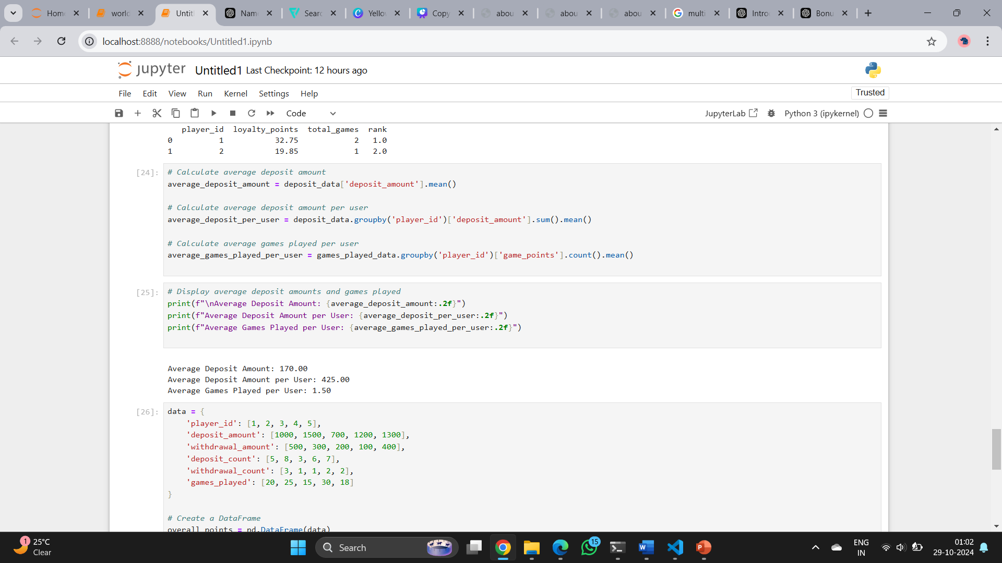
OUTPUT
Average Deposit Amount: The average amount deposited across all transactions is 170.00.
Average Deposit Amount per User: On average, each user deposits 425.00 in total.
Average Games Played per User: Each user plays an average of 1.5 games.

Slide 22
Part B - Bonus Allocation
Ranking: Identify the top 50 players.
Bonus Distribution: Propose a method for distributing the Rs 50,000 bonus fairly among these players.

Slide 23
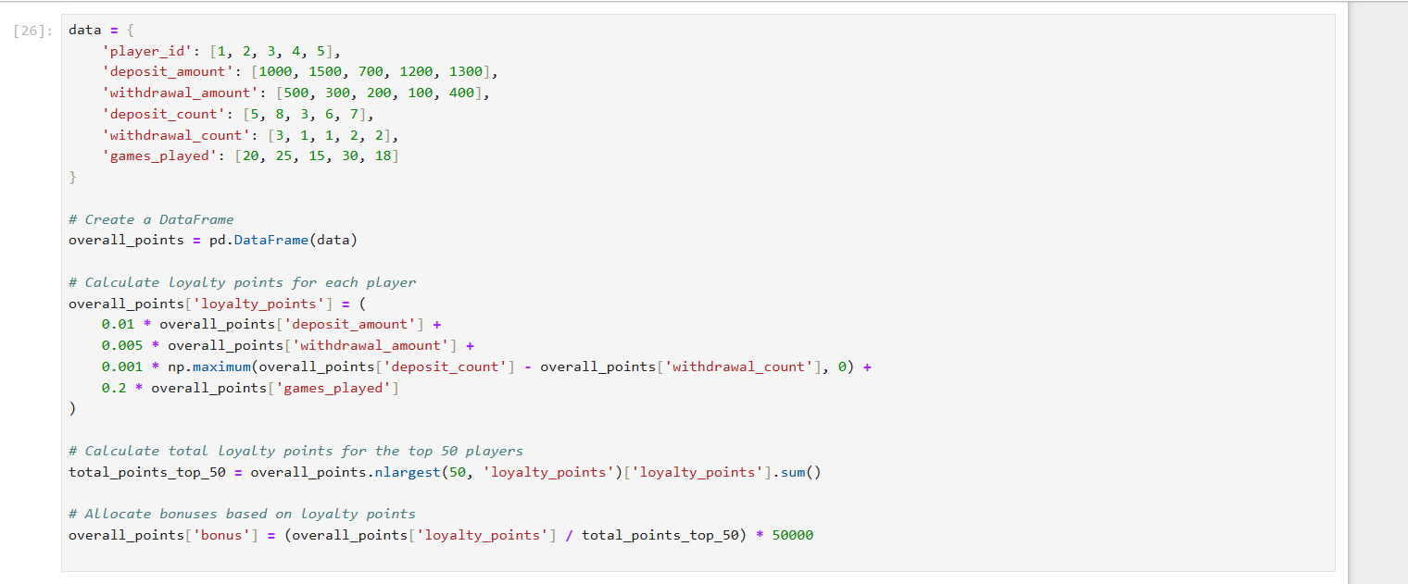

Slide 24
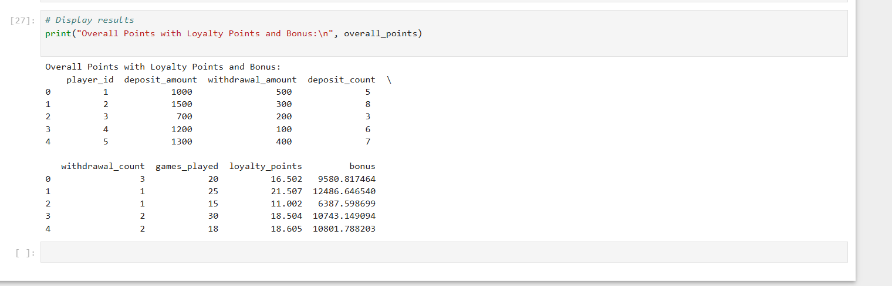
OUTPUT
Bonuses based on Loyalty Points

Slide 25
To fairly divide the allocated money among the top 50 ranked players:
Proportionate Division: Calculate each player’s loyalty points as a percentage of the total points of the top 50 players.
Bonus Calculation: Award each player a bonus based on their percentage of the total, multiplied by the total bonus pool (e.g., $50,000).
This way, higher-ranked players receive a larger share, but all top 50 receive a proportional bonus.

Slide 26
Part C - Evaluation of Fairness
Review: Assess the fairness of the loyalty points formula and its impact on player retention.
Recommendations: Suggest improvements to enhance the robustness of the loyalty points system.

Slide 27
The loyalty point formula is fairly reasonable but could be improved to balance rewards better.
Here’s a simplified approach to make it more robust:
Lower Withdrawal Points: Reduce or cap points from withdrawals to limit excess rewards for actions that reduce engagement.
Consistency Bonus: Reward small bonuses for frequent deposits or game play streaks to encourage regular participation.
Higher Points for Games: Increase points per game to promote gameplay as a key activity.
This structure makes the loyalty system fairer by focusing more on beneficial actions for both players and the platform.

Slide 28
CONCLUSION
This analysis calculated loyalty points for players on Company ABC's platform based on deposits, withdrawals, and games played in October.
We ranked players by total points, considering game activity for ties. The average deposit was Rs 170, and players averaged 1.5 games. A total of Rs 50,000 in bonuses was allocated to the top 50 players based on their loyalty points, promoting continued engagement.
Overall, the loyalty points system effectively rewards player activity but could be improved for fairness.

Slide 29
THANK YOU

